Slide 1
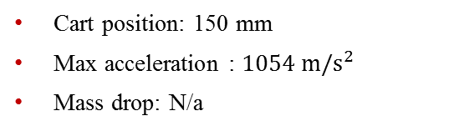
Datasets
High-Rate Overview
Benchmark
Applications
Datasets
Dataset 5 – test 13
Excitations:
Static cart action
Single hammer impact
No electromagnet mass
Cart position: 150 mm
Max acceleration : $1054 m/s^{2}$
Mass drop: N/a

Slide 2
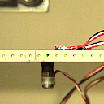
Datasets
High-Rate Overview
Benchmark
Applications
Datasets
Dataset 5 – test 13
Excitations:
Static cart action
Single hammer impact
No electromagnet mass
Cart position: 150 mm
Max acceleration : $1054 m/s^{2}$
Mass drop: N/a

Slide 3

Datasets
High-Rate Overview
Benchmark
Applications
Datasets
Dataset 5 – test 14
Excitations:
Static cart action
Single hammer impact
No electromagnet mass
Cart position: 150 mm
Max acceleration : $1156 m/s^{2}$
Mass drop: N/a

Slide 4
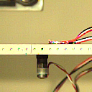
Datasets
High-Rate Overview
Benchmark
Applications
Datasets
Dataset 5 – test 14
Excitations:
Static cart action
Single hammer impact
No electromagnet mass
Cart position: 150 mm
Max acceleration : $1156 m/s^{2}$
Mass drop: N/a

